Slide 1
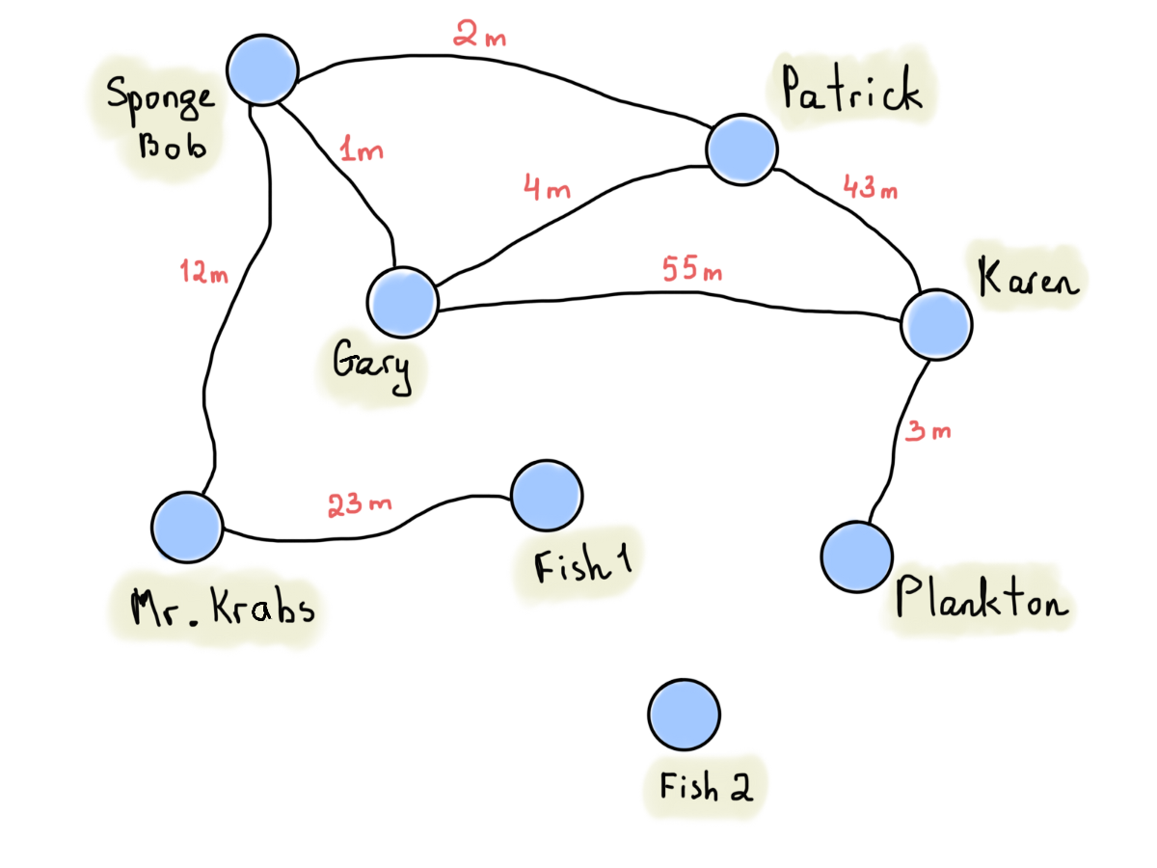

Practice classifying a graph
Classify the graph:
simple directed weighted cyclic
non-simple undirected unweighted acyclic
connected
disconnected

Slide 2
Practice classifying a graph
If Fish 2 was removed, it would be a simple connected graph, which is the type of graph we’ll typically study.

Slide 3
Walk definition
A walk is a sequence of edges which joins a sequence of vertices
Sponge Bob → Patrick → Sponge Bob → Gary → Karen)

Slide 4
Walk definition
A closed walk is a walk that starts and ends at the same vertex.
Sponge Bob → Patrick → Karen → Patrick → Sponge Bob

Slide 5
Trail definition
A trail is a walk in which all edges are distinct. Sponge Bob → Gary → Patrick → Sponge Bob → Mr. Krabs

Slide 6
Trail definition
A closed trail is known as a circuit. Sponge Bob → Patrick → Gary → Karen → Plankton → Gary → Sponge Bob

Slide 7
Path definition
A path is a trail in which all vertices are distinct (except perhaps the start and ending vertices).
Sponge Bob → Gary → Patrick → Karen

Slide 8
Cycle definition
A closed path is known as a cycle.
Gary → Patrick → Karen → Gary
A cycle contains a path, but is not itself a path.

Slide 9
Classifying Walks 1
Given a group of edges & nodes from a graph
i.e. possible to traverse?
Walk
edges distinct? (i.e. edges don’t repeat)
Trail
vertices distinct?
Path
start=end?
Cycle

Slide 10
Classifying Walks 2
Classifying Types of Walks
 | Edges may repeat | Vertices may repeat
Walk | yes | yes
Trail | no | yes
Path | no | no*
* Except the start and end can match

Slide 11
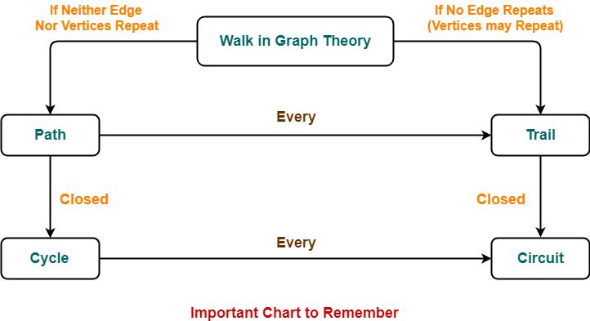
Classifying walk 3

Slide 12
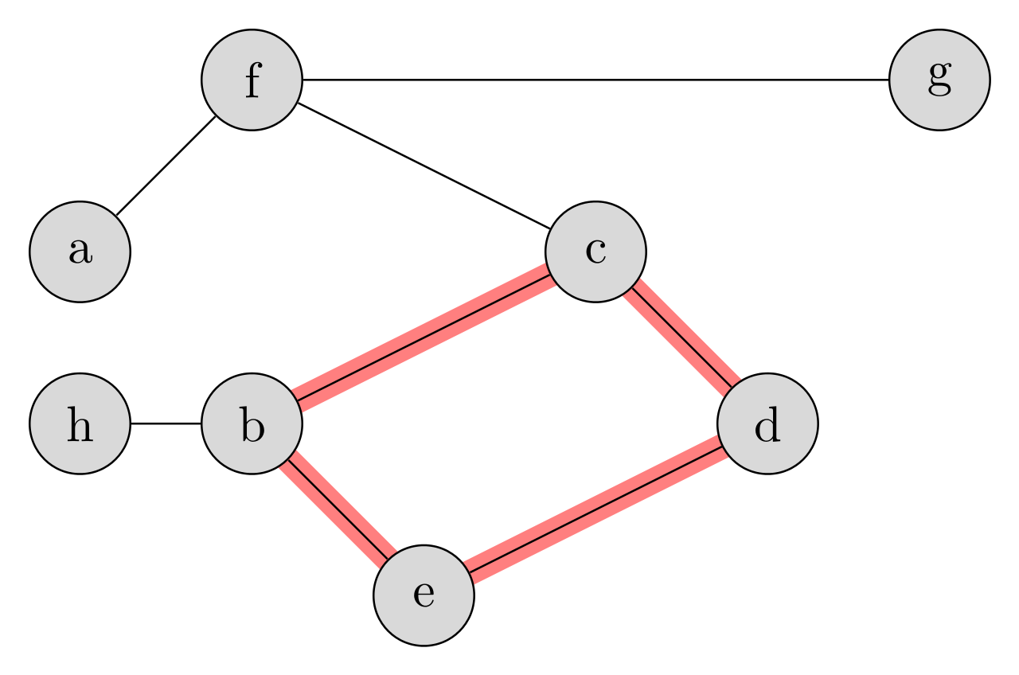
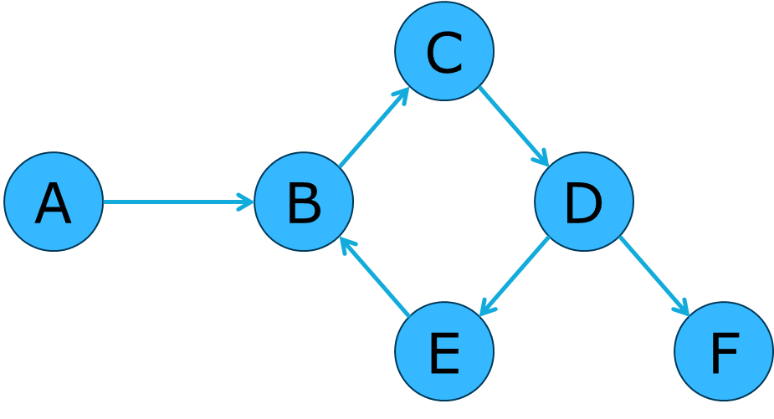
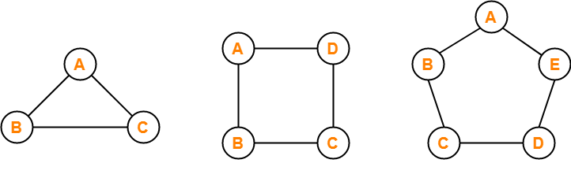
Cyclic Graphs and Cycle Graphs
A cyclic graph contains a cycle.
A circular graph is a cycle.
Notes:
A cycle/circular graph is a cycle. I.e. it contains one cycle, and that cycle traverses all of the vertices.

Slide 13
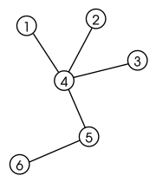
Cyclic Graphs and Cycle Graphs
An acyclic graph contains no cycles.
It’s also known as a tree.
Notes:
A cycle/circular graph is a cycle. I.e. it contains one cycle, and that cycle traverses all of the vertices.

Slide 14
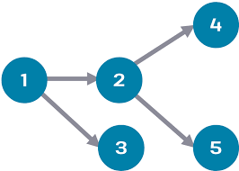
Cyclic Graphs and Cycle Graphs
Directed acyclic graphs (DAGs) have numerous scientific and computational applications.
Notes:
A cycle/circular graph is a cycle. I.e. it contains one cycle, and that cycle traverses all of the vertices.

Slide 15
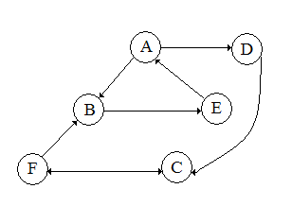
Practice finding Walks
A walk is a sequence of vertices that is possible to traverse.
Which is not a walk?
AA
FCF
ABEA
ABEAD
FBEABE
FBEADC
FCD
FCD
Since this is a directed graph, (F, C) and (C, F) are considered distinct edges!

Slide 16
Practice finding Trails
A trail is a walk where none of the edges repeat.
Which is not a trail?
AA
FCF
ABEA
ABEAD
FBEABE
FBEADC
FBEABE

Slide 17
Practice finding Paths
A path is a walk where none of the edges or vertices repeat (except maybe the last).
Which trail is not a path?
AA
FCF
ABEA
ABEAD
FBEADC
ABEAD
A trail could be a single path, or it could be multiple connected paths.

Slide 18
Practice finding Cycles
A cycle is a closed path. I.e. no vertices repeat except for the first and last vertices.
Which path is not a cycle?
AA
FCF
ABEA
FBEADC
FBEADC

Slide 19
Length of a Walk
The length of a walk is the number of edges that the path uses.
AA – length 1
AD – length 1
ABEA – length 3
FBEADC – length 5

Slide 20
Counting Walks in Adjacency Matrices
How many walks of length 1
exist in this Adjacency matrix?
4
B
 | A | B | C
A | 0 | 1 | 1
B | 1 | 0 | 0
C | 1 | 0 | 0
A
C
Notes:
It’s difficult to be sure you’ve found all walks of a length greater than one by hand, so we multiply matrices instead.

Slide 21
Counting Walks in Adjacency Matrices
How many walks of length 2 exists in this Adjacency matrix?
 | A | B | C
A | 0 | 1 | 1
B | 1 | 0 | 0
C | 1 | 0 | 0
Notes:
It’s difficult to be sure you’ve found all walks of a length greater than one by hand, so we multiply matrices instead.

Slide 22
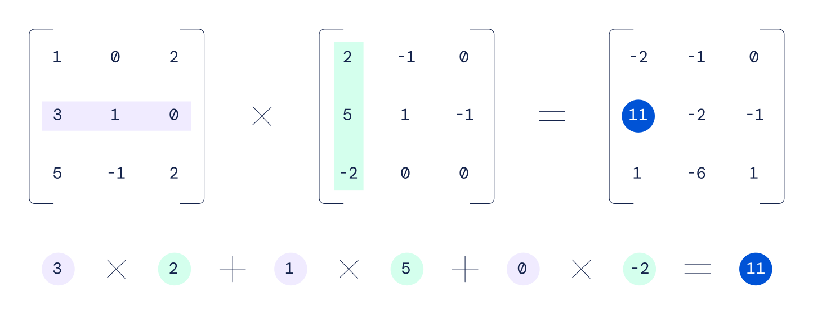
Matrix Multiplication

Slide 23
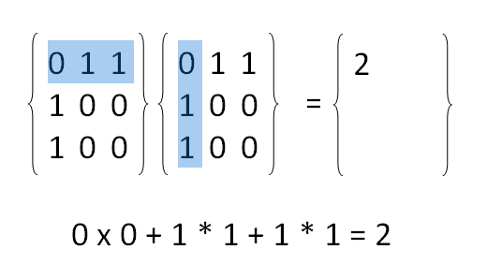
Matrix Multiplication

Slide 24
Counting Walks in Adjacency Matrices
How many walks of length 2 exist in this Adjacency matrix?
6
B
 | A | B | C
A | 2 | 0 | 0
B | 0 | 1 | 1
C | 0 | 1 | 1
A
C
Notes:
It’s difficult to be sure you’ve found all walks of a length greater than one by hand, so we multiply matrices instead.

Slide 25
Old terminology
FYI, some older texts use the terms path and simple path where we use walk and path. : (

